Slide 1
Cyber Cloud Security
Presented by
- Shilpa Batthineni
- Pratyush Gaggenapalli
Notes:
Our project is regrading Cyber Cloud Security. In this, we are mainly focusing on security attacks & vulnerabilities like AWS access keys leakage on public repositories and DoS attack on AWS servers.

Slide 2
Cloud Infrastructure and Security
Cloud infrastructure is a virtual platform that provides virtual resources like storage, servers, networks, and software over the internet as a service for a smooth application experience.
Cloud security is defined as a collection of security measures designed to protect cloud-based infrastructure, applications, and data.
Notes:
So to begin with, we will start with Cloud Infrastructure, We all know the concept of virtualization,/ i.e., creating multiple virtual environments from a single physical servers./ So,/ the cloud infrastructure uses this same concept of virtualization/ and / provides resources and environments / on-demand for the users.
Cloud security is defined as a collection of security measures which include user and device authentication, data and resource access control, and data privacy protection.
Cloud security is employed in cloud environments to protect a company's data from distributed denial of service (DDoS) attacks, malware, hackers, and unauthorized user access or use.

Slide 3
Types of Cloud environments
There are mainly three types of cloud environments
Public clouds
Private clouds
Hybrid clouds.
Each of these environments has different security concerns and benefits.
Notes:
Types of Cloud environments –
When you're looking for cloud-based security, you'll find three main types of cloud environments to choose from. The top options on the market include public clouds, private clouds, and hybrid clouds. Each of these environments has different security concerns and benefits, so it's important to know the difference between them:

Slide 4
Continuation …..
Public clouds
Security features, such as access control, identity management, and authentication, are crucial to public clouds.
Private clouds
Security challenges from some threats, such as social engineering and breaches are encountered.
Hybrid clouds
Working with hybrid cloud demands flexibility in data movement between public and private clouds that can can fall prey to intruder attacks.
Notes:
Public clouds - Public cloud services are hosted by third-party service providers. A company doesn't have to set up anything to use the cloud, since the provider handles it all. Usually, clients can access a provider's web services via web browsers. Security features, such as access control, identity management, and authentication, are crucial to public clouds.
Private clouds - Private clouds are typically more secure than public clouds, as they're usually dedicated to a single group or user and rely on that group or user's firewall. The isolated nature of these clouds helps them stay secure from outside attacks since they're only accessible by one organization. However, they still face security challenges from some threats, such as social engineering and breaches. These clouds can also be difficult to scale as your company's needs expand.
Hybrid clouds - Hybrid clouds combine the scalability of public clouds with the greater control over resources that private clouds offer. These clouds connect multiple environments, such as a private cloud and a public cloud, that can scale more easily based on demand. Successful hybrid clouds allow users to access all their environments in a single integrated content management platform.

Slide 5
Security Attacks on Cloud
Several attacks such as flooding, authentication, and man-in-the-middle cryptographic attacks can be conducted against cloud computing.
One of these security threats is a denial-of-service (DoS) attack, which is an event or malicious behavior that mitigates or prevents a cloud’s capacity to perform its expected functions and services
Notes:
Several attacks such as flooding, and authentication, and one of these security threats is denial-of-service (DoS) attack, which is any event or malicious behavior that mitigates or prevents a cloud’s capacity to perform its expected functions and services. Distributed form of DoS attacks is called distributed DoS (DDoS) attack, which applies numerous network hosts to inflict more devastating effects to its victim.

Slide 6
HTTP flood DDoS attack on AWS
An HTTP flood attack is a type of volumetric distributed denial-of-service (DDoS) attack designed to overwhelm a targeted server with HTTP requests.
Once the target has been saturated with requests and is unable to respond to normal traffic, denial-of-service will occur for additional requests from actual users.
Notes:
In an HTTP flood attack, an attacker sends HTTP requests that appear to be from a valid user of the web application to the targeted server and exhausts its CPU and other resources, which makes the server not responsive to the actual requests.

Slide 7
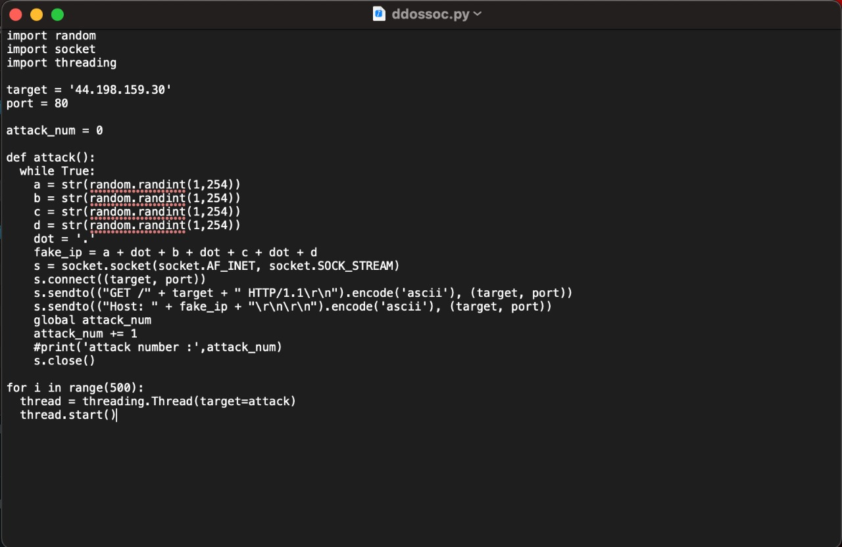
DDoS Attack using Socket Functionality

Slide 8
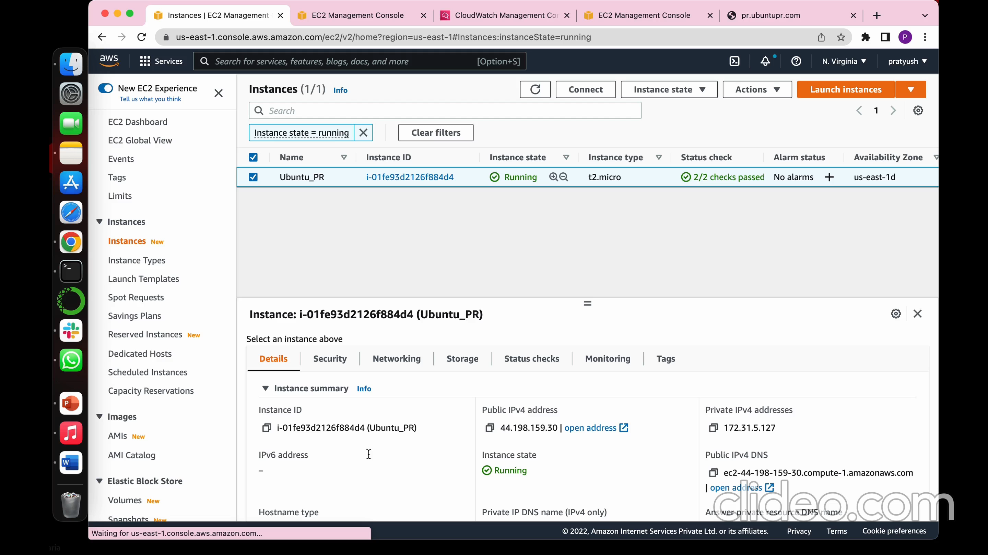
Demo

Slide 9
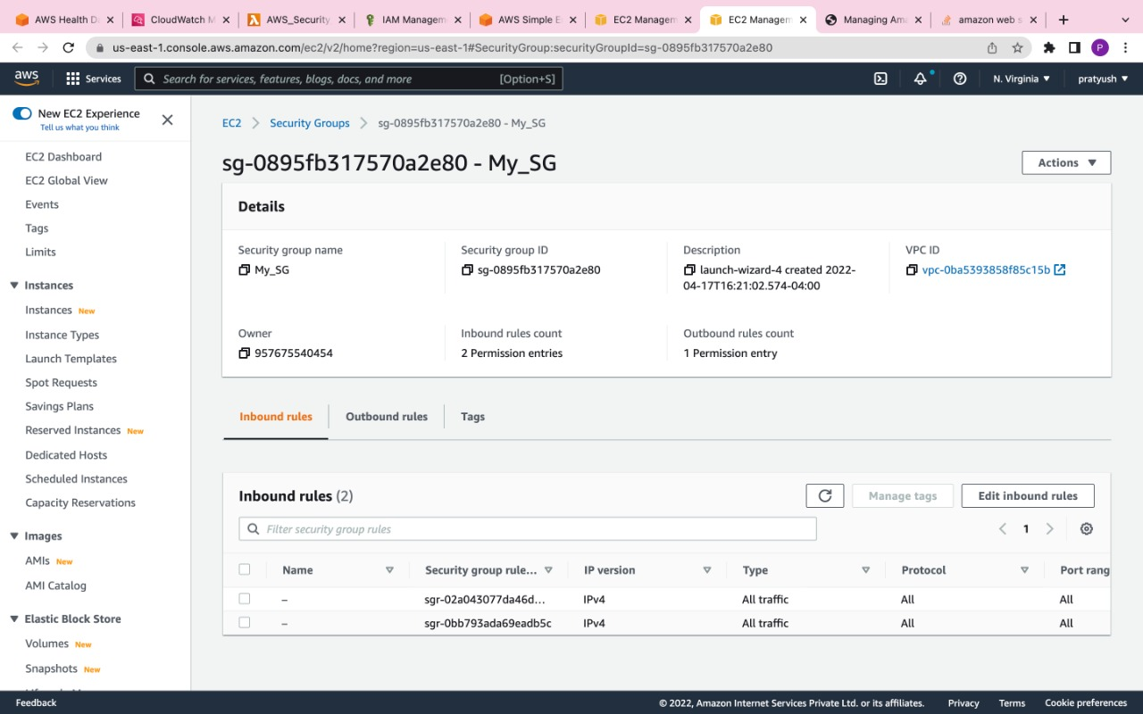
Security Groups Configurations on AWS

Slide 10
AWS Access Keys Leak in Public Repo
An access key leak via a public code repository is a quite known security problem. When pushing code to GitHub, anything that looks like an AWS access key is immediately identified by robots around the world, most of them are malicious in intent.
When we uploaded the keys in less than 10 minutes, we got an email from Amazon notifying me about the compromised keys.

Slide 11
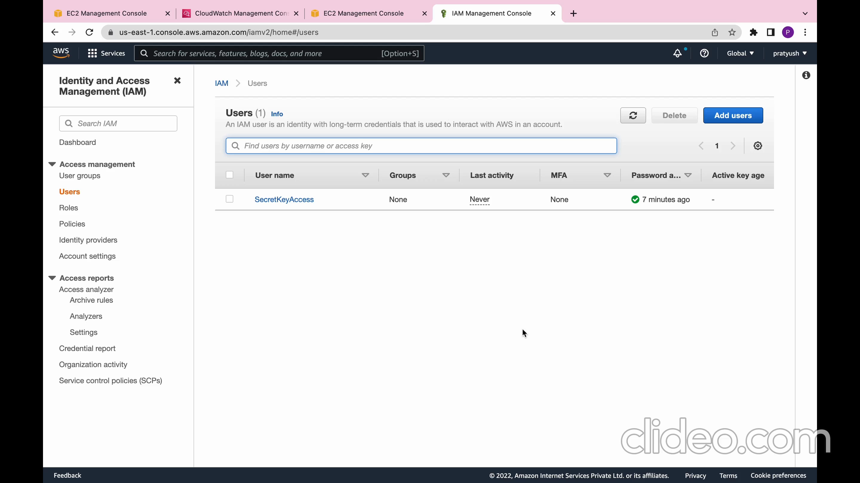
Demo

Slide 12
AWS security audit guidelines
Organizations should periodically audit your security configuration to make sure it meets your current business needs.
An audit gives you an opportunity to remove unneeded IAM users, roles, groups, and policies, and to make sure that your users and software have only the permissions that are required.

Slide 13
Thank You

